Slide 1
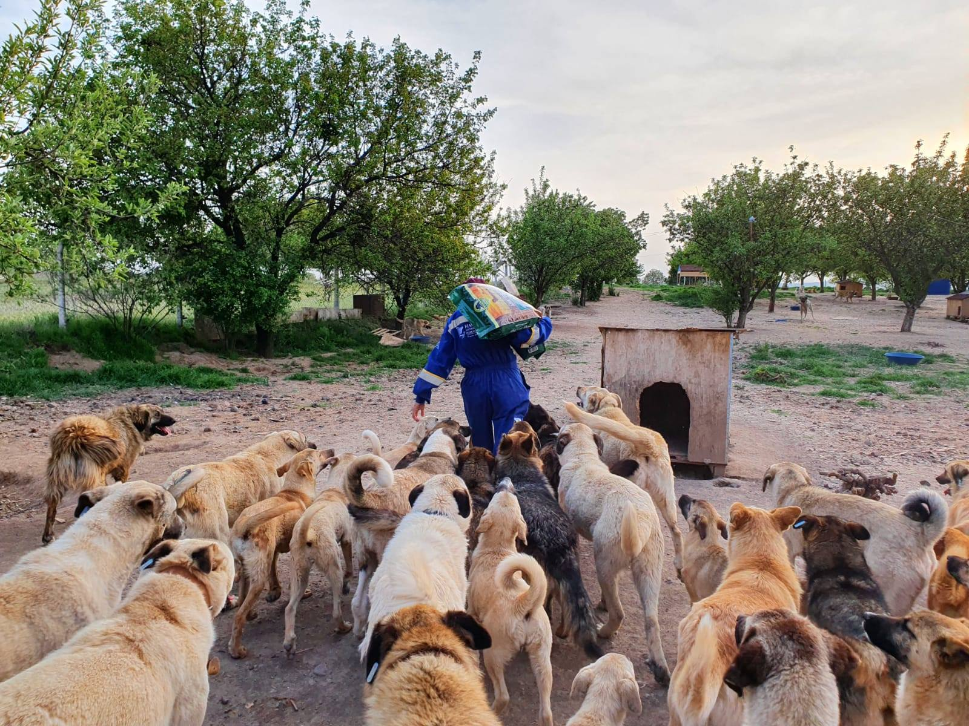
“NEUTER & RETURN”

Slide 2
STRAY DOG POPULATION CONTROL: DEFINITION
The scope of these success examples and recommendations is to deal with stray and feral dogs, which pose serious human health, animal health and welfare problems and have a socio-economic, environmental, political and religious impact in many countries.
Human health, including the prevention of zoonotic diseases, notably rabies, is a priority. Dog population management is an integral part of rabies control programs.
Veterinary Services should play a lead role in ensuring animal welfare and should be involved in dog population control, coordinating their activities with other competent public institutions and/or agencies.
Key definition:
Stray dog: means any dog not under direct control by a person or not prevented from roaming.

Slide 3
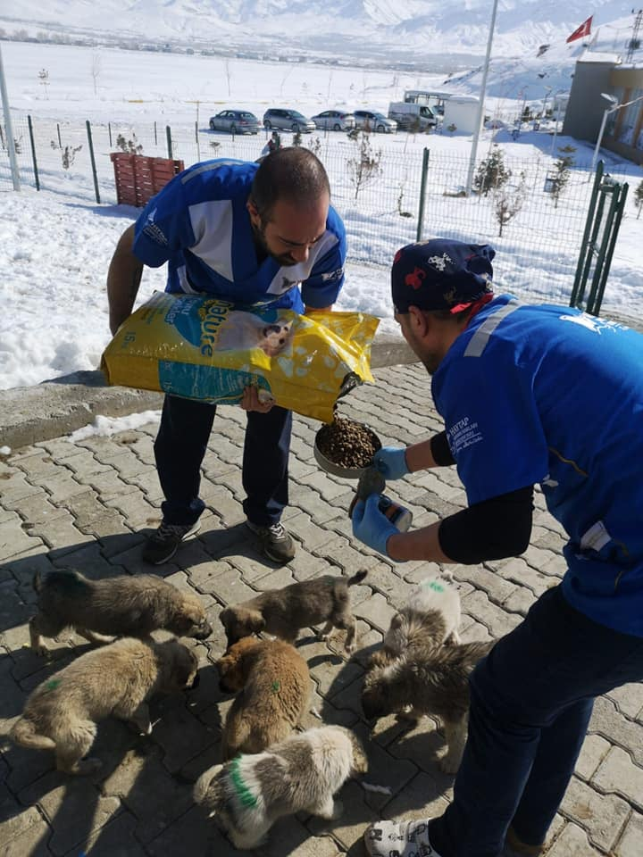
STRAY DOG POPULATION CONTROL: OBJECTIVES
Dog population control program objectives
The objectives of a program to control the dog population may include the following:
1) improve health and welfare of owned and stray dog population;
2) reduce numbers of stray dogs to an acceptable level;
3) promote responsible ownership;
4) assist in the creation and maintenance of a rabies immune or rabies free dog population;
5) reduce the risk of zoonotic diseases other than rabies;
6) manage other risks to human health (e.g. parasites);
7) prevent harm to the environment and other animals;
8) prevent illegal trade and trafficking.

Slide 4
STRAY DOG POPULATION CONTROL: KEY STEPS
1. Education and legislation for responsible ownership
Encouraging dog owners to be more responsible will reduce the number of dogs allowed to roam, improve the health and welfare of dogs, and minimise the risk that dogs pose to the community. The promotion of responsible dog ownership through legislation and education is a necessary part of a dog population control programme. Collaboration with local government authorities, animal welfare NGOs, kennel clubs, private veterinarians and veterinary organisations will assist Veterinary Authorities in establishing and maintaining programmes.
2. Registration and identification of dogs (licensing)
A core component of dog population control by the Competent Authorities is the registration and identification of owned dogs. This may include granting licences to owners and breeders. Registration and identification may be emphasized as part of responsible dog ownership and are often linked to animal health programmes, for example, mandatory rabies vaccination and traceability.
Registration of animals in a centralised database can be used to support the enforcement of legislation and the reuniting of lost animals with owners. The control of dog reproduction by sterilisation can be encouraged through financial incentives presented by differential licensing fees.
3. Reproductive control
Controlling reproduction in dogs prevents the birth of unwanted puppies and can help address the balance between demand for dogs and the size of the population. It is advisable to focus efforts to control reproduction on those individuals or groups in the dog population identified as the most productive and the most likely to be the sources of unwanted and stray dogs, to ensure best use of resources. Methods for controlling reproduction in dogs include:
a) surgical sterilisation;
b) chemical sterilisation;
c) chemical contraception;
d) separation of female dogs during oestrus from unsterilised males.

Slide 5
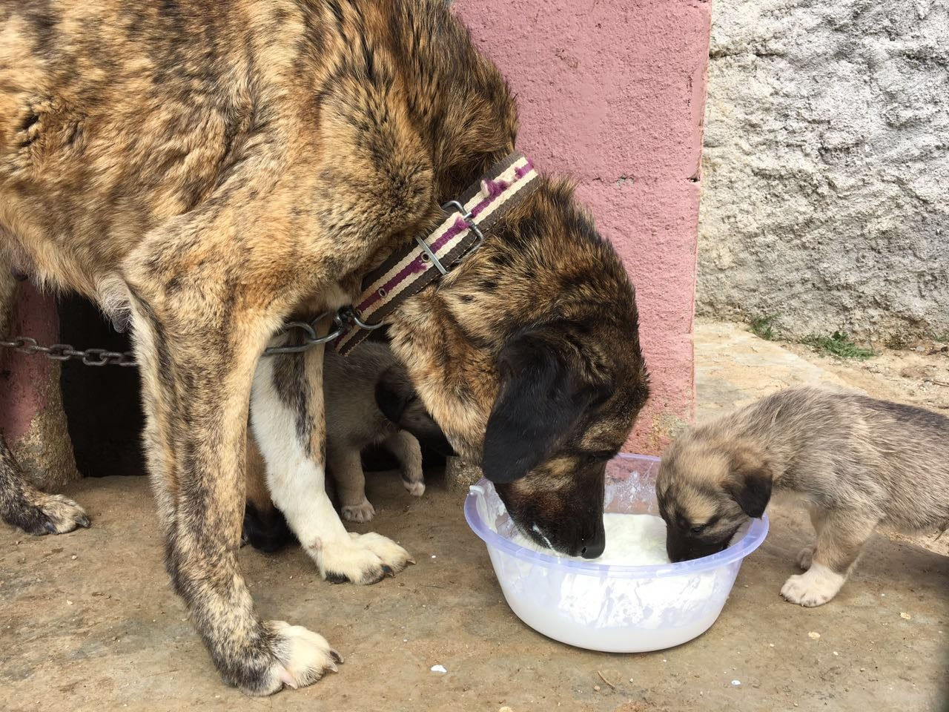
STRAY DOG POPULATION CONTROL: KEY STEPS
4. Removal and handling
The Competent Authority should collect dogs that are not under direct supervision and verify their ownership. Capture, transport, and holding of the dogs should be done humanely. The Competent Authority should develop and implement appropriate legislation and training to regulate these activities. Capture should be achieved with the minimum force required and equipment should be used that supports humane handling. Uncovered wire loops should not be used for capture.
5. Capture and return, rehoming or release
Competent Authorities have the responsibility to develop minimum standards for the housing (physical facilities) and care of these dogs. There should be provision for holding the dogs for a reasonable period of time to allow for reunion with the owner and, as appropriate, for rabies observation.
6. Environmental controls
Steps should be taken to exclude dogs from sources of food (e.g. rubbish dumps and abattoirs, and installing animal-proof rubbish containers).
This should be linked to a reduction in the dog population by other methods, to avoid animal welfare problems.
7. Control of dog movement — international (export/import)
Chapter 1.1. provides recommendations on the international movement of dogs, with respect to provisions for rabies.

Slide 6
STRAY DOG POPULATION CONTROL: KEY STEPS
8. Control of dog movements — within country (e.g. leash laws, roaming restrictions)
Measures for the control of dog movement in a country are generally invoked for the following reasons:
a) for rabies control when the disease is present in a country;
b) for public safety reasons;
c) for the safety of ‘owned dogs’ in an area or locality when a stray dog control programme is in place;
d) to protect wildlife and livestock.
9. Regulation of commercial dog dealers
Dog breeders and dealers should be encouraged to form or join an appropriate association. Such associations should encourage a commitment to the raising and selling of physically and psychologically healthy dogs, as unhealthy dogs may be more likely to be abandoned to become part of the stray population. They should encourage breeders and dealers to provide advice on proper care to all new owners of dogs. Regulations covering commercial dog breeders and dealers should include specific requirements for accommodation, provision of suitable food, drink and bedding, adequate exercise, veterinary care and disease control and may require breeders and dealers to allow regular inspection, including veterinary inspection.
10. Reduction in dog bite incidence
The most effective means of reducing prevalence of dog bites are education and placing responsibility on the owner. Dog owners should be educated in principles of responsible dog ownership as described in point 1 of Article 7.7.6.) Legal mechanisms that enable the Competent Authorities to impose penalties or otherwise deal with irresponsible owners are necessary. Mandatory registration and identification schemes will facilitate the effective application of such mechanisms. Young children are the group at highest risk for dog bites. Public education programmes focussed on appropriate dog-directed behaviour have been demonstrated to be effective in reducing dog bite prevalence and these programmes should be encouraged. Authorities should seek advice from dog behaviour experts in developing dog safety education programmes.
11. Euthanasia
When euthanasia is practised, the general principles in the Terrestrial Code should be followed, with the emphasis on using the most practical, rapid and humane methods and ensuring operator safety. Regardless of the method used, it is important to minimise distress, anxiety and pain by ensuring that operators are appropriately trained.

Slide 7
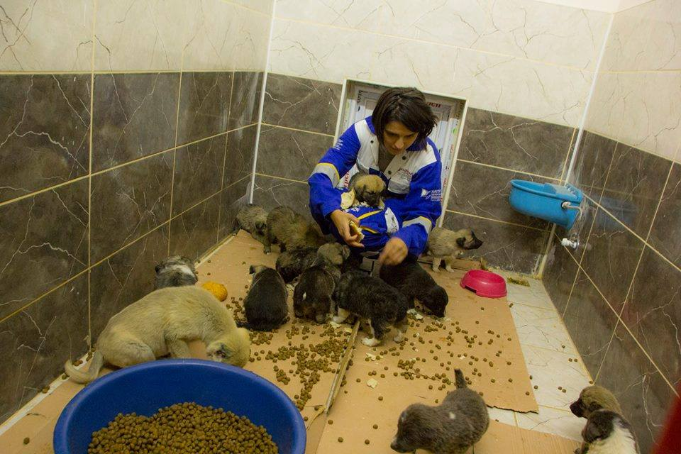
STRAY DOG POPULATION CONTROL: ROMANIA SUCCESS STORY
Situation:
Romania has a serious dog problem. There is a huge excess of dogs in and around the streets – and not enough responsible owners willing to look after and neuter these dogs.
Since Romania became a democracy in 1990 politicians have been unwilling to get to grips with the root cause of the problem. They have failed to understand where these unwanted dogs come from. They have failed to study dog ecology.
They have embarked on sporadic and expensive dog extermination campaigns which invariably fail.
Where neutering campaigns have been tried they have not been financed or managed properly, nor have they concentrated on the source of the problem – owned or semi-owned dogs.

Slide 8
STRAY DOG POPULATION CONTROL: ROMANIA SUCCESS STORY
Success:
In 2004 (when SOS Dogs started) there were at least 4200 unsupervised dogs in Oradea, a density of 70 unsupervised dogs per square km
By 23.09.2006 SOS Dogs Oradea had reduced the number of unsupervised dogs to about 1224, a density of 20.4 dogs per sq.km.
By 30.04.2010 we had further reduced the number of unsupervised dogs in Oradea to 10.5 dogs per sq.km., making a total unsupervised population of 630 dogs.
Additionally there are at least another 10 owned dogs per sq.km which are properly supervised.

Slide 9
STRAY DOG POPULATION CONTROL: ROMANIA SUCCESS STORY
CATCH AND KILL – a waste of money and doomed to failure.
Many cities in Romania have attempted over the last 20 years to solve their dog problem by collecting dogs from the streets and killing them – usually in barbaric ways.
Why does Catch & Kill always fail ?
Because it is aimed at the wrong target.
The source of the street dog problem is not feral dogs foraging for food. The most reproductively successful dogs are those with owners, or feeders or protectors. Very few puppies from feral dogs survive. Many puppies from well-fed dogs at petrol stations, factories, blocks of flats, car parks etc. do survive, at least initially to breeding age.
When municipal dog catchers come to collect and kill these well-fed “semi-owned” dogs, obviously the people tolerating those dogs protect them. Some even bribe dog catchers to leave their dogs alone.
Therefore the problem is not the dogs themselves. We need to enlist the help of the citizens feeding and protecting dogs to have all fertile dogs sterilised.

Slide 10
STRAY DOG POPULATION CONTROL: ROMANIA SUCCESS STORY
THE ONLY MEDIUM-TERM SOLUTION – NEUTER & RETURN.
As we have shown in Bihor dog owners or semi-owners will co-operate with Neuter & Return programmes providing these are implemented by credible, humane and efficient animal welfare organisations. Some dog keepers such as gypsy communities or factory personnel soon overcome their initial mistrust when they see their dogs being returned to them after a few days vaccinated, neutered and healthy.
This programme cannot however be implemented successfully by poorly motivated and uneducated municipal workers – and certainly not by the same people who were previously catching, poisoning and killing dogs.

Slide 11
STRAY DOG POPULATION CONTROL: ROMANIA SUCCESS STORY
COST OF NEUTER AND RETURN Versus CATCH AND KILL.
Based on an average dog of 20 kg.
To catch and kill as per the law costs: Tranquillising Euros 3.81 per dog.
Feeding (14 days) € 5,- per dog
Anaesthetic € 1,01 per dog
Euthanasia solution € 3.47 per dog.
Incineration of body € 10,- per dog.
TOTAL excl. TVA : € 23,29 per dog.
To neuter and return costs: Collecting/catching by hand by NGO: nil
Anaesthetic : € 1,01 per dog
Sutures, analgesic : € 4,17 per dog
Feeding (5 days) : € 1,77 per dog
TOTAL excl. TVA : € 6,95 per dog.

Slide 12
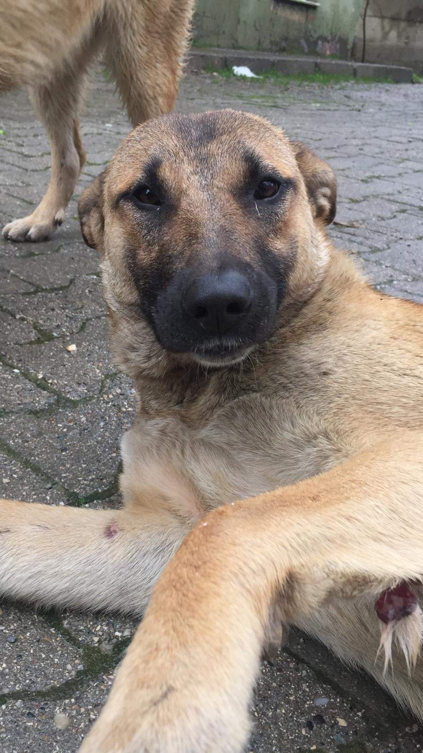
STRAY DOG POPULATION CONTROL: PROJECT PROPOSAL FOR ISTANBUL
‘Neuter and Release’.
‘In the long term, control of reproduction is by far the most effective strategy of dog population management’ - W.H.O. Geneva Guidelines for Dog Population Management.
Extermination campaigns, for example the recent indiscriminate strychnine poisoning of dogs at night irrespective of whether they are neutered and
vaccinated or indeed pets with owners, have never succeeded in Istanbul.
‘Neuter and Release’, the policy advocated by the World Health Organisation and the World Society for the Protection of Animals, solves the problem permanently, although dogs have to be tolerated on the streets for 3-5 years for it to succeed. Providing it is implemented to the edge of the urban area it is however a permanent and humane solution which politicians can be proud of.
Istanbul needs to invest money and effort now to solve the problem for ever.

Slide 13
STRAY DOG POPULATION CONTROL: PROJECT PROPOSAL FOR ISTANBUL
NEUTER AND RELEASE PLAN
FOR A TYPICAL MUNICIPALITY WITH
4000 STRAY DOGS (human population 407000).
Assumptions:
1. That the average life of a street dog (i.e. all unsupervised dogs free to breed) which survives to breeding age is between 3.5 and 4 years. So 12.5% dies every 6 months.
2. That the male:female population at birth and the death rate are 50:50 (although the ‘owned’ dog population may
be slightly more biased towards males in reality).
3. That a well trained vet team can neuter 9 females and 1 or 2 males per day.
4. That recuperation facilities are available for 50 dogs per clinic.
5. That all females have 2 litters per annum with 8 live births per litter. Although this is high for feral dogs, up to 70% of the dogs may be ‘owned’ or abandoned owned dogs.
6. That 50% of live puppies dies before they can breed.
7. That only the same number of surviving puppies will live until breeding age as older dogs which die during the same period for as long as the carrying capacity of the area is full; and that the others die of hunger, weakness etc.
8. That clinics practise early age neutering from age 3 months upwards if necessary on litters of surviving puppies, rather than releasing puppies un-neutered.

Slide 14
STRAY DOG POPULATION CONTROL: PROJECT PROPOSAL FOR ISTANBUL
NEUTER AND RELEASE PLAN
FOR A TYPICAL MUNICIPALITY WITH
4000 STRAY DOGS (human population 407000).
Assumptions:
9. That the female dogs which die naturally (250 per half year for the first 5 years of the project) do not breed in the half year of their deaths, or if they do, that none of their puppies survives.
10. That each clinic employs two dog catching/release teams at night and one team during the day 6 days per week. SHKD caught and neutered 289 dogs in the first 3 months of 2000 in Besiktas with one dog catching team. A target of
90 dogs per team per month is therefore feasible.
11. That dog owners who allow their dogs to stray, or who abandon them, will bring them to the clinic for free
neutering and vaccination and will therefore not distort the diminishing reproduction rate, or alternatively, that all of such abandoned dogs can be picked up.
12. That priority is given to neutering females before males. The neutering of males has limited short term impact on the population.
13. That all surrounding municipalities follow the same policy to the edge of the conurbation.
14. That 70% of females are caught and neutered in the first 6 months. That 80% of the remaining fertile females are caught and neutered in the next 18 months. And that 90% of remaining fertile females are done in the fifth and sixth 6 month seasons when our teams will have more time to concentrate on catching difficult dogs.

Slide 15
STRAY DOG POPULATION CONTROL: PROJECT PROPOSAL FOR ISTANBUL
NEUTER AND RELEASE PLAN
FOR A TYPICAL MUNICIPALITY WITH
4000 STRAY DOGS (human population 407000).
Results:
- Within 1 year over 90% of the stray dog population is vaccinated against rabies.
- Within 5 years the stray dog population is reduced to 27.8% of present levels.
- Within 6 years the stray dog population is virtually eliminated (as in W. Europe).
If more females than 645 can be caught in the 2nd 6 month period - i.e. 725 females (90% of the remaining fertile females incl. puppies) - the process will be speeded up.
If the average life span of the female street dogs is 2.5 to 3 years rather than the 3.5 to 4 years projected the stray dog population will almost die out within 4 years.

Slide 16
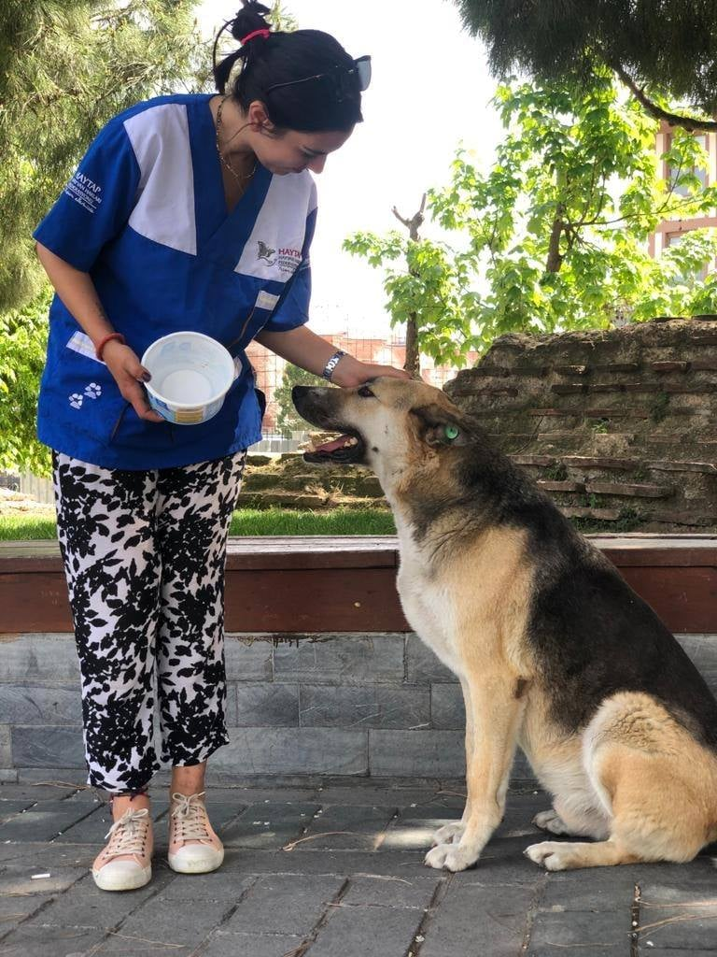
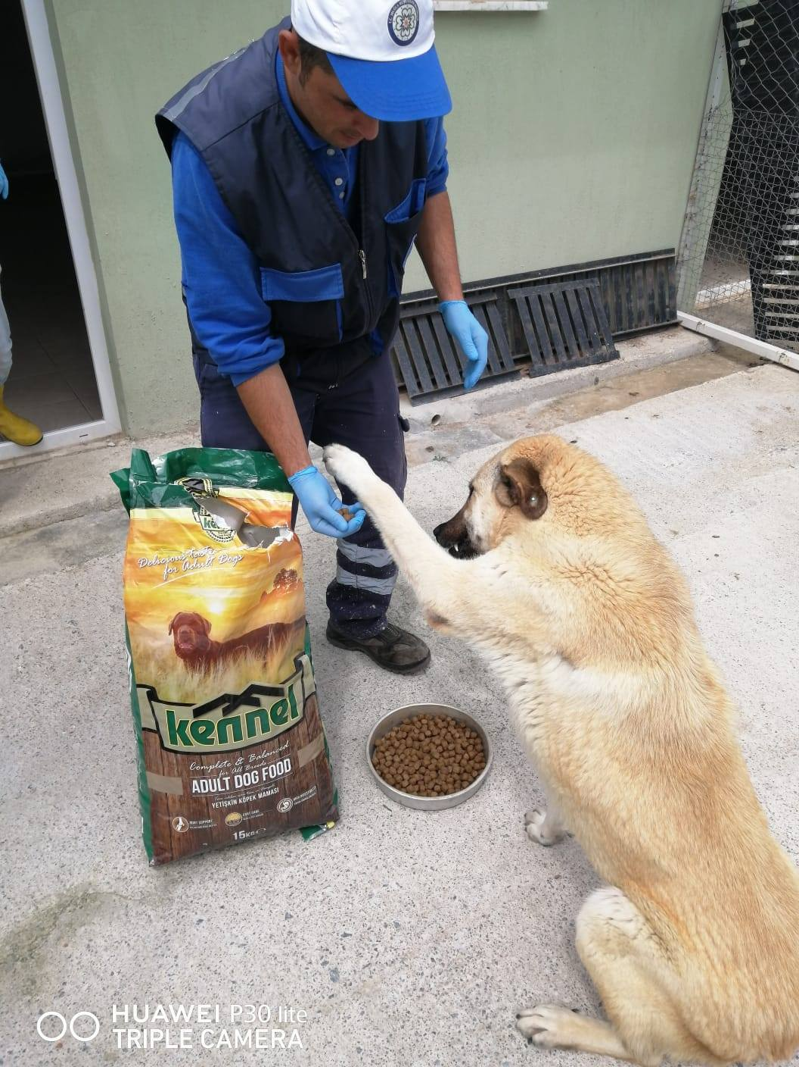
STRAY DOG POPULATION CONTROL: PROJECT PROPOSAL FOR ISTANBUL
Personnel required in each clinic (Year 1).
Wage costs incl. tax and SSK.
Manager $ 625
Vet $ 730
4 drivers $ 500 each
3 dog catchers $ 500 each
2 vet assistants $ 460 each
1 cleaner $ 410
1 night guard $ 410
Lunch and bus passes $ 545
Total : $ 7140 per month
One-off expenditure
2 vans $ 32000
50 cages $ 6000
6 catching cages $ 1200
Furniture $ 1000
6 catch poles $ 700
Vet equipment $ 4300
2 tranq. guns $ 2000
Gloves, clothing $ 800
Rabies inoculations $ 1000
Other $ 1000
Total: $ 50.000,-
Clinic Building: $ 35.000,-
Other monthly costs:
Fuel for vans $ 250
Cleaning materials $ 100
Medicine/vaccines $ 3400
Dogfood $ 300
Phone incl mobiles $ 200
Other incl repairs $ 100
Total $ 4350

Slide 17
STRAY DOG POPULATION CONTROL: PROJECT PROPOSAL FOR ISTANBUL
Monthly costs (year 1) $ 11490,-
Year 2: 2 drivers and 2 dog catchers are sufficient (personnel $5640/month)
less fuel, dogfood, medicine, vaccines (so other costs $ 2500/month)
Monthly costs (year 2) $ 8200,-
Year 3: 1 driver, 1 dog catcher, 1 asst vet are sufficient (pers. $4000/month)
less fuel, dogfood, medicine etc. (so other costs $ 1700/month)
Monthly costs (year 3) $ 5700,-
ANNUAL COSTS per clinic:
Year 1: Building + eqpmt $ 85.000,- Personnel incl lunch/tr. $85.680,-
Other costs $ 52200,-
TOTAL: $ 222.880,-
Year 2: Personnel incl lunch/tr. $ 67.680,- Other $ 30000,-
TOTAL: $ 97.680,-
Year 3: Personnel incl lunch/tr. $ 48000,- Other $ 20400,-
TOTAL: $ 68.400,-
TOTAL COST PER CLINIC OVER 3 YEARS: US $ 388.960,000-

Slide 18
STRAY DOG POPULATION CONTROL: PROJECT PROPOSAL FOR ISTANBUL
How to fund this project?
A main sponsor should be sought to sponsor the whole project. This could be a bank, a pharmaceutical or consumer products company or one of the large holding companies with diverse interests. Their name would appear on all publicity, on the vehicles and on the clinics. Secondary sponsors such as ,
dogfood manufacturers should also be sought.
If the clinic buildings and equipment, the vehicles and the advertising were all sponsored this would save about $ 1.66 million.
Many companies would be interested in sponsoring a socially beneficial project with short term beneficial results for the human (and canine) population of Istanbul which is supported and supervised by the Governor and/or Greater Istanbul Municipality.

Slide 19
THANK YOU

